Slide 1
Mining Structural Hole Spanners in Social Networks
Jie Tang
Department of Computer Science and Technology
Tsinghua University

Slide 2






Social Networks
>1000 million users
The 3rd largest “Country” in the world
More visitors than Google
>800 million users
2013, users, 40% yearly increase
560 million
2009, 2 billion tweets per quarter
2010, 4 billion tweets per quarter
2011, tweets per quarter
25 billion
More than 6 billion images
Pinterest, with a traffic higher than Twitter and Google
Notes:
http://www.statisticbrain.com/twitter-statistics/

Slide 3
A Trillion Dollar Opportunity
Social networks already become a bridge to connect our daily physical life and the virtual web space
On2Off ^{[1]}
[1] Online to Offline is trillion dollar business
http://techcrunch.com/2010/08/07/why-online2offline-commerce-is-a-trillion-dollar-opportunity/
Notes:
With the growth of local commerce on the Web, the links between online and physical commerce are becoming stronger.
The key to O2O is that it finds consumers online and brings them into real-world stores. . It is a combination of payment model and foot traffic generator for merchants (as well as a “discovery” mechanism for consumers) that creates offline purchases. It is inherently measurable, since every transaction (or reservation, for things like OpenTable) happens online. This is distinctively different from the directory model (think: Yelp, CitySearch, etc) in that the addition of payment helps quantify performance and close the loop—more on that later.
What do Groupon, OpenTable,Restaurant.com, and SpaFinder all have in common? They grease the wheels of online-to-offline commerce.

Slide 4
Core Research in Social Network
Application
Prediction
Search
Information Diffusion
Advertise
Macro
Meso
Micro
Social Network Analysis
BA model
ER model
Community
Group behavior
Structural hole
Social tie
Action
Social influence
Theory
Social Theories
Algorithmic Foundations
BIG Social Data

Slide 5
Today, let us start with the notion of “structural hole”…

Slide 6
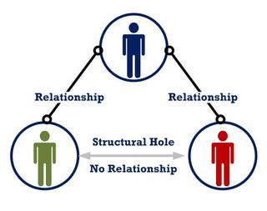
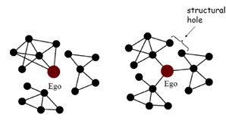
What is “Structural Hole”?
Structural hole: When two separate clusters possess non-redundant information, there is said to be a structural hole between them.^{[1]}
Structural hole spanner
Structural hole spanner
[1] R. S. Burt. Structural Holes: The Social Structure of Competition. Harvard University Press, 1992.
Notes:
Mark Granovetter (1973) argued that the presence of weak ties in social networks were important aspects of social structure through which novelty is likely to flow, such as information important for finding a new job. Burt (1992) took Granovetter's argument a step further with the concept of "structural holes." Structural holes can be found in the vicinity of nodes with high betweenness centrality that mediate connections between two or more otherwise isolated cliques. In contrast to Coleman's view of social capital inherent in closed, Burt argued, and empirically demonstrated, that open networks connected via bridges across structural holes carried more consistent social benefits.

Slide 7
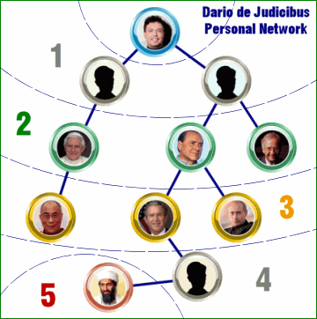
Few People Connect the World
Six degree of separation^{[1]}
In that famous experiment…
Half the arrived letters passed through the same three people.
It’s not about how we are connected with each other. It’s about how we are linked to the world through few “gatekeepers”^{[2]}.
How could the letter from a painter in Nebraska been received by a stockbroker in Boston?
[1] S. Milgram. The Small World Problem. Psychology Today, 1967, Vol. 2, 60–67
[2] M. Gladwell. The Tipping Point: How Little Things Can Make A Big Difference. 2006.
Notes:
Famous Six Degrees of Separation experiment: 160 people are given letters in Nebraska, and instructed to ferry them to a particular stockbroker in Boston by passing the letters along to a colleague socially closer to the target.

Slide 8
Structural hole spanners control information diffusion…
The theory of Structural Hole [Burt92]:
  “Holes” exists between communities that are otherwise disconnected.
Structural hole spanners
  Individuals would benefit from filling the “holes”.
Community 2
Community 1
On Twitter, Top 1% twitter users control 25% retweeting flow between communities.
Information diffusion
Community 3
Notes:
What is structural hole? Structural hole first introduced by Burt in 1992, which states that.
“Holes” exists between communities.
Please look at the picture, this is a social network consists of 3 communities. There are only a few connections between communities, this phenonen is also called structural holes.
What is structural hole spanner? They are the users who filling the “holes”. For example, a0 and a5 act as a bridge position between communities, they’re likely to be viewed as structural hole spanners.
One important property for spanners is that, they are richer in information.
We discover an interesting phenomena on the twitter network. 1 - 25.
There’re many previous works proof the existance of structural holes. For example, in 2008, Kleinberg use games to model the dynamic of structural holes.
What we want to do is : the reverse process of previous works. Given the social network, how to detect structural hole spanners?

Slide 9




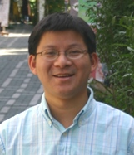
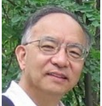

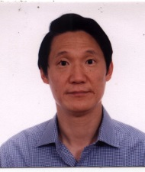
Examples of DBLP & Challenges
Data Mining
Database
  82 overlapped PC members of SIGMOD/ICDT/VLDB and SIGKDD/ICDM during years 2007 – 2009.
Challenge 1 : Structural hole spanner vs Opinion leaders
Challenge 2 : Who control the information diffusion?
Notes:
Before talking about the challenges of the work, let’s have a concrete example : DBLP.
The picture shows a coauthor network, vertices are experts in DM and DB.
There are super users very activity in both communities. And they’re believed to act as structural hole spanners in the network.
In fact, there are 82 common program committee members of top conference in both DM and DB.
These authors could apply ideas and techniques from one area to the other, and benefit from the position.
There are two challenges of the problem.
The first challenge is the correlation between SHS and OL. (You may wonder why not use betweenness as the measurement for SHS. Betweenness of one node is the number of shortest path it lies on. The reason is that : real social networks are densely connected, the results via betweenness are more likely to be OLs instead of SHS. )
We agree that most SHS are OLs, but what’s the main difference between them?
We believe SHS have a richer information, The second challenge is that, but who control the information diffusion?

Slide 10
Mining Top-k Structural Hole Spanners
[1] T. Lou and J. Tang. Mining Structural Hole Spanners Through Information Diffusion in Social Networks. In WWW'13. pp. 837-848.

Slide 11
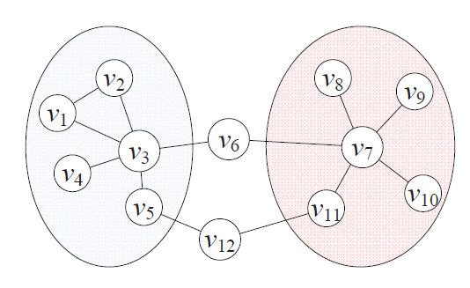
Problem Definition
Which node is the best structural hole spanner?
Community 2
Community 1
Well, mining top-k structural hole spanners is more complex…
Notes:
The input of the problem is a social network, a graph G. And associate with communities information.
So the community is the input of the our problem.
What we want to do is to maximize the following function.
Here Q, is the utility function, to measure how a subset of vertices span structural holes.
Q is a General definition, can be instantiate in many ways, like:
Number of path between communities.
Number of edges between key members among communities
And the VSH is exactly the top-k structural hole spanners we want to compete.

Slide 12
Problem definition
INPUT :
  A social network, G = (V, E) and L communities C = (C₁, C₂, …, C_{L})
Identifying top-k structural hole spanners.
max Q(V_{SH}, C), with |V_{SH}| = k
  Utility function Q(V*, C) : measure V*’s degree to span structural holes.
V_{SH} : Top-k structural holes spanners as a subset of k nodes
Notes:
The input of the problem is a social network, a graph G. And associate with communities information.
So the community is the input of the our problem.
What we want to do is to maximize the following function.
Here Q, is the utility function, to measure how a subset of vertices span structural holes.
Q is a General definition, can be instantiate in many ways, like:
Number of path between communities.
Number of edges between key members among communities
And the VSH is exactly the top-k structural hole spanners we want to compete.

Slide 13
Data
 | #User | #Relationship | #Messages
Coauthor | 815,946 | 2,792,833 | 1,572,277 papers
Twitter | 112,044 | 468,238 | 2,409,768 tweets
Inventor | 2,445,351 | 5,841,940 | 3,880,211 patents
In Coauthor, we try to understand how authors bridge different research fields (e.g., DM, DB, DP, NC, GV);
In Twitter, we try to examine how structural hole spanners control the information diffusion process;
In Inventor, we study how technologies spread across different companies via inventors who span structural holes.
Notes:
In our work, we consider three different networks.
Coauthor is a network of authors, people are linked by coauthorships.
On twitter, we used following links among the users.
Inventor is a network of patents, we study the co-inventing relationship.
All these networks consists of millions of nodes and edges.
In addition, we also have papers, tweets and patents information of the networks, and we will use them to track the information diffusion process.

Slide 14
Our first questions
Observable analysis
  How likely would structural hole spanners connect with “opinion leaders” ?
  How likely would structural hole spanners influence the “information diffusion”?
Notes:
The first one is, (difference between )
The second one is, (information spread )

Slide 15
Structural hole spanners vs
Opinion leaders
Structural hole vs.
Opinion leader vs. Random
Result: Structural hole spanners are more likely to connect important nodes
+15% - 50%
The two-step information flow theory^{[1]} suggests structural hole spanners are connected with many “opinion leaders”
[1] E. Katz. The two-step flow of communication: an up-to-date report of an hypothesis. In Enis and Cox(eds.), Marketing Classics, pages 175–193, 1973.
Notes:
(1) Observation (2) case

Slide 16
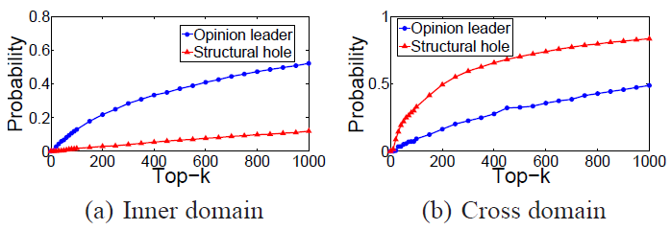
Structural hole spanners control the information diffusion
Opinion leaders 5 times higher
Structural hole spanners 3 times higher
  Results: Opinion leaders controls information flows within communities, while Structural hole spanners dominate information spread across communities.
Notes:
we perform another analysis of information diffusion in the Twitter and Coauthor networks.
In twitter, we estimate the probability of OL and SHS appearing on a tweet forward path.
The result shows an interesting phenomena, OL dominate in inner domain information spread, which is 5 times higher than SHS, but on the other hand, SHS almost 3 times the cross domain information flows.

Slide 17
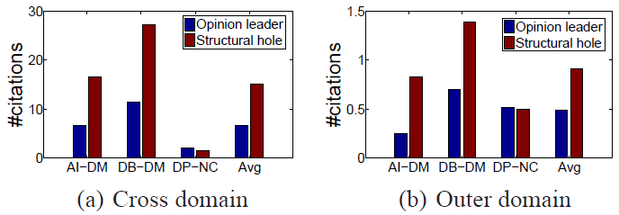
Structural hole spanners influence the information diffusion
In the Coauthor network :
  Structural hole spanners almost double opinion leaders on number of cross domain (and outer domain) citations.
Notes:
In coauthor, we consider the citation as a type of information diffusion.
SHS almost double OL the number of cross domain and outer domain citation.
Cross domain citation is only aimed for cites from other computer science areas.
Outer domain citation is only aimed for cites from non-CS areas, other areas like math and biology.

Slide 18
Intuitions
Structural hole spanners are more likely to connect important nodes in different communities.
Structural hole spanners control the information diffusion between communities.
Model 1 : HIS
Model 2 : MaxD
Notes:
To summize the obersavation, we have 2 intuitions,
1) …
2) …
Based on these two intuitions, we design two models.

Slide 19
Models, Algorithms, and Theoretical Analysis

Slide 20
Model One : HIS
Structural hole spanners are more likely to connect important nodes in different communities.
  If a user is connected with many opinion leaders in different communities, more likely to span structural holes.
  If a user is connected with structural hole spanners, more likely to act as an opinion leader.
Notes:
Based on the first intuition.
For example, v3 and v7 are Ols in two communities, so they have more power to spread information than other nodes v5 and v11,
V6 and v12 can be considered as the bridge to connect two communities.
And v6 have a higher advantage than v12, since v6 connects two OL and v12 only connects two ordinary users.
On the other hand, a node is more likely to act as an OL, if it connects with structural hole spanners.
We develop the first model as the following mutual recursion formulas.
I(v, C) is ..
H(v, S) is ..
A and b are ….

Slide 21
Model One : HIS
Structural hole spanners are more likely to connect important nodes in different communities.
  If a user is connected with many opinion leaders in different communities, more likely to span structural holes.
  If a user is connected with structural hole spanners, more likely to act as an opinion leader.
Model
  I(v, C_{i}) = max { I(v, C_{i}), α_{i} I(u, C_{i}) + β_{S} H(u, S) }
  H(v, S) = min { I(v, C_{i}) }
  I(v, C_{i}) : importance of v in community C_{i}.
  H(v, S) : likelihood of v spanning structural holes across S (subset of communities).
α and β are two parameters
Notes:
Essentially, in Eq. 2, the importance score can be explained as the maximal information flow a user can receive from one of her/his friends.
Eq. 3 suggests that a structural hole spanner in S should be active in all the communities in S. The two update rules, Eqs. 2 and 3 are the basic approaches by which structural holes and importance (authority) reinforce each other.

Slide 22
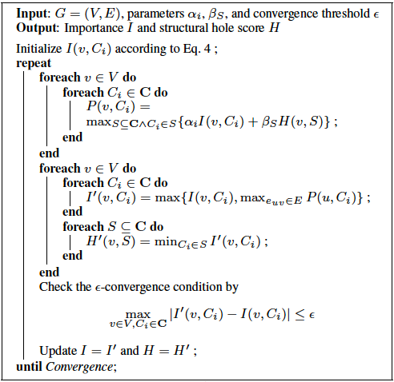

Algorithm for HIS
By PageRank or HITS
Parameter to control the convergence

Slide 23
Theoretical Analysis—Existence
Given α_{i} and β_{S}, solution exists ( I(v, C_{i}), H(v, S) ≤ 1 ) for any graph, if and only if, α_{i} + β_{S} ≤ 1.
  For the only if direction
    Suppose α_{i} + β_{S} > 1, S = {C_{blue}, C_{yellow}}
    r(u) = r(v) = 1;
    I(u,C_{blue}) = I(u,C_{yellow}) = 1;
    H(u,S) = min { I(u, C_{blue}), I(u, C_{yellow})}=1;
    I(v, C_{yellow}) ≥ α_{i} I(u, C_{i}) + β_{S} H(u, S) = α_{i} + β_{S} > 1
u
v
  I(v, C_{i}) = max { I(v, C_{i}), α_{i} I(u, C_{i}) + β_{S} H(u, S) }
  H(v, S) = min { I(v, C_{i}) }
Notes:
We first proof the only if direction. Suppose we have two communities, one is blue, another is yellow. Two vertex U and V are connected with each other. Vertex V belongs to yellow and vertex U belongs to both yellow and blue. And we are looking for the structural hole between blue and yellow.
Suppose alpha + beta > 1, and the initial value of u and v both equals to 1. Thus the importance scores of vertex U in blue and yellow are also one, which is the same with its structural hole score. By the updating equation, we find that I(v, C_yellow) >= alpha + beta > 1, which is impossible.

Slide 24
Theoretical Analysis—Existence
Given α_{i} and β_{S}, solution exists ( I(v, C_{i}), H(v, S) ≤ 1 ) for any graph, if and only if, α_{i} + β_{S} ≤ 1.
  For the if direction
    If α_{i} + β_{S} ≤ 1, we use induction to prove I(v, C_{i}) ≤ 1;
    Obviously I⁽⁰⁾(v, C_{i}) ≤ r(v) ≤ 1;
    Suppose after the k-th iteration, we have I^{(k)}(v, C_{i}) ≤ 1;
    Hence, in the (k + 1)-th iteration, I^{(k+1)}(v, C_{i}) ≤ α_{i}I^{(k)}(u, C_{i}) + β_{S}H^{(k)}(u, S) ≤ (α_{i} + β_{S})I^{(k)}(u, C_{i}) ≤ 1.
  I(v, C_{i}) = max { I(v, C_{i}), α_{i} I(u, C_{i}) + β_{S} H(u, S) }
  H(v, S) = min { I(v, C_{i}) }

Slide 25
Theoretical Analysis—Convergence
Denote γ = α_{i} + β_{S} ≤ 1, we have
|I^{(k+1)}(v, C_{i}) - I^{(k)}(v, C_{i})| ≤ γ^{k}
  When k = 0, we have I⁽¹⁾(v, C_{i}) ≤ 1, thus
  |I⁽¹⁾(v, C_{i})-I⁽⁰⁾(v, C_{i})| ≤ 1
  Assume after k-th iteration, we have
  |I^{(k+1)}(v, C_{i})-I^{(k)}(v, C_{i})| ≤ γ^{k}
  After (k+1)-th iteration, we have
  I^{(k+2)}(v, C_{i}) = α_{i}I^{(k+1)}(u, C_{i}) + β_{S}H^{(k+1)}(u, S)
  ≤ α_{i}[I^{(k)}(u, C_{i})+γ^{k}] + β_{S}[H^{(k+1)}(u, S)+γ^{k}]
  ≤ α_{i}I^{(k)}(u, C_{i}) + β_{S}H^{(k+1)}(u, S) + γ^{k+1}
  ≤ I^{(k+1)}(u, C_{i}) + γ^{k+1}

Slide 26
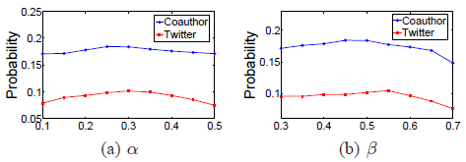
Convergence Analysis
Parameter analysis.
  The performance is insensitive to the different parameter settings.
Notes:
We proof condition of existance, and e-convergence property.
After designing an iteratie algorithm, we conduct parameter analysis, show that the performance……

Slide 27
Model Two: MaxD
The minimal cut D of a set communities C is the minimal number of edges to separate nodes in different communities.
The structural hole spanner detection problem can be cast as finding top-k nodes such that after removing these nodes, the decrease of the minimal cut will be maximized.
Removing V6 decreases the minimal cut as 2
Two communities with the minimal cut as 4

Slide 28
Model Two: MaxD
Structural holes spanners play an important role in information diffusion
Q(V_{SH}, C) = MC (G, C) – MC (G \ V_{SH}, C)
MC(G, C) = the minimal cut of communities C in G.
Notes:
The first model basicly consider the correlation between SHS and OL. but not consider information diffusion.
So, In the second model, we explicitly use information flows in the quality function.
Here we define MC() as the minimal cut of communities in the graph.
What we want to do is to find a subset of nodes, such that without them, the connection between communities would be minimized.

Slide 29
Hardness Analysis
Q(V_{SH}, C) = MC (G, C) – MC (G \ V_{SH}, C)
Hardness analysis
  If |V_{SH}|= 2, the problem can be viewed as minimal node-cut problem
  We already have NP-Hardness proof for minimal node-cut problem, but the graph is exponentially weighted.
  Proof NP-Hardness in an un-weighted (polybounded -weighted) graph, by reduction from k-DENSEST-SUBGRAPH problem.
Notes:
The idea of the second model is straightforward, but it’s harder to find an efficient algorithm to optimize it.
Even when there are only 2 communities. The problem can be viewed as ….
………….
………. Which is not practical in real networks.
We rewrite the proof such that, the edges.

Slide 30
Hardness Analysis
Let us reduce the problem to an instance of the k-DENSEST SUBGRAPH problem
Given an instance {G’=<V, E>, k, d} of the k-DENSEST SUBGRAPH problem, n=|V|, m=|E|;
Build a graph G with a source node S and target node T;
Build n nodes connecting with S with capacity n*m;
Build n nodes for each edge in G’, connect each of them to T with capacity 1;
X₁
Y₁
1
1
n*m
1
Y₂
1
T
X₂
S
1
.
.
.
.
.
.
1
1
n*m
X_{n}
Y_{n*m}
Notes:
The idea of the second model is straightforward, but it’s harder to find an efficient algorithm to optimize it.
Even when there are only 2 communities. The problem can be viewed as ….
………….
………. Which is not practical in real networks.
We rewrite the proof such that, the edges.

Slide 31
Hardness Analysis (cont.)
Build a link from x_{i} to y_{j} with capacity 1 if the x_{i} in G’ appears on the j-th edge;
MC(G)=n*m;
The instance is satisfiable, if and only if there exists a subset
|V_{SH}|=k
such that
MC(G\V_{SH}) <= n(m-d)
X₁
Y₁
1
1
n*m
1
Y₂
1
T
X₂
S
1
.
.
.
.
.
.
1
1
n*m
X_{n}
Y_{n*m}

Slide 32
Proof: NP-hardness (cont.)
For the only if direction
  Suppose we have a sub-graph consists of k nodes {x’} and at least d edges;
  We can choose V_{SH}={x};
  For the k-th edge y in G’, if y exists in the sub-graph, two nodes appearing on y are removed in G;
  Thus y cannot be reached and we lost n flows for y;
  Hence, we have MC(G \ V_{SH}) <= n*(m-d).

Slide 33
Proof: NP-hardness (cont.)
For the if direction
  If there exists a k-subset V_{SH} such that MC(G\V_{SH}) <= n*(m-d);
  Denote V_{SH}’=V_{SH}^{x}, the size of V_{SH}’ is at most k, and MC(G\V_{SH}’) <= n*(m-d);
  Let the node set of the sub-graph be V_{SH}’, thus there are at least d edges in that sub-graph.

Slide 34
Approximation Algorithm
Two approximation algorithms:
  Greedy: in each iteration, select a node which will result in a max-decrease of Q(.) when removed it from the network.
  Network-flow: for any possible partitions E_{S} and E_{T}, we call a network-flow algorithm to compute the minimal cut.
An example: finding top 3 structural holes
Step 1: select V8 and decrease the minimal cut from 7 to 4
Step 2: select V6 and decrease the minimal cut from 4 to 2
Step 3: select V12 and decrease the minimal cut from 2 to 0

Slide 35
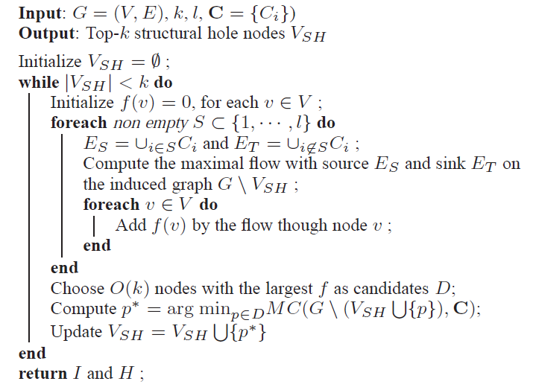
Approximation Algorithm
Greedy : In each round, choose the node which results in the max-decrease of Q.
  Step 1: Consider top O(k) nodes with maximal sum of flows through them as candidates.
Step 2: Compute MC(*, *) by
trying all possible partitions.
Complexity: O(2^{2l}T₂(n)); T₂(n)—the complexity for computing min-cut Approximation ratio: O(log l)
Notes:
Since the problem is NP-hard, we design approximation algorithm using greedy strategy.
In each round, we choose one node to maximal decrease of MC.
To scale up the algorithm to large networks, we only consider top O(k) nodes with
Maximal sum of flows though them as candidates.
One more challenge is to estimate MC(), when L > 2, it’s NP-Hard to get the exact number, so we design a O(logL) approximation by trying all possible partitions of communities.

Slide 36
Results

Slide 37
Experiment
 | #User | #Relationship | #Messages
Coauthor | 815,946 | 2,792,833 | 1,572,277 papers
Twitter | 112,044 | 468,238 | 2,409,768 tweets
Inventor | 2,445,351 | 5,841,940 | 3,880,211 patents
Evaluation metrics
  Accuracy (Overlapped PC members in the Coauthor network)
  Information diffusion on Coauthor and Twitter.
Baselines
  Pathcount: #shortest path a node lies on
  2-step connectivity: #pairs of disconnected neighbors
  Pagerank and PageRank+: high PR in more than one communities

Slide 38
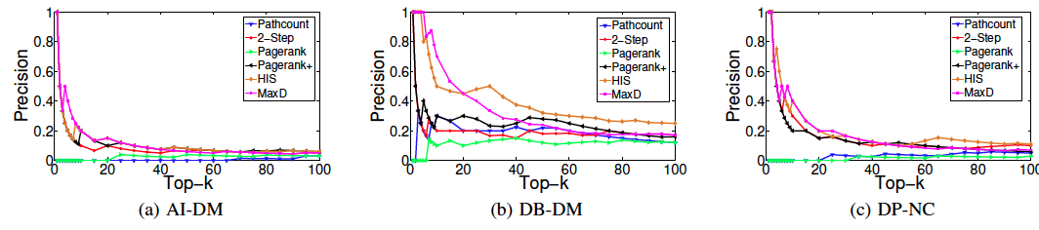
Experiments
Accuracy evaluation on Coauthor network
Predict overlapped PC members on the Coauthor network.
  +20 – 40% on precision of AI-DM, DB-DM and DP-NC
What happened to AI-DM?

Slide 39
Experiment results (accuracy)
What happened to AI-DB?
  Only 4 overlapped PC members on AI and DB during 2007 – 2009, but 40 now.
  Our conjecture : dynamic of structural holes.
  Structural holes spanners of AI and DB form the new area DM.
Similar pattern for
1) Collaborations between experts in AI and DB.
2) Influential of DM papers.
Significantly increase of coauthor links of AI and DB around year 1994.
Most overlapped PC members on AI and DB are also PC of SIGKDD
Notes:
For overlapped PC members, more precisely, common members of AI-DM, DB-DM and DP-NC.
Both models outperform 20 – 40%.
You may wonder why no AI-DB.
The reason is simple, ………
We also dig into the data, and have the following interesting conjecture, related to the dynamics of strctural holes.
………
There are 3 factors behind our points.
………
2......
3…..

Slide 40
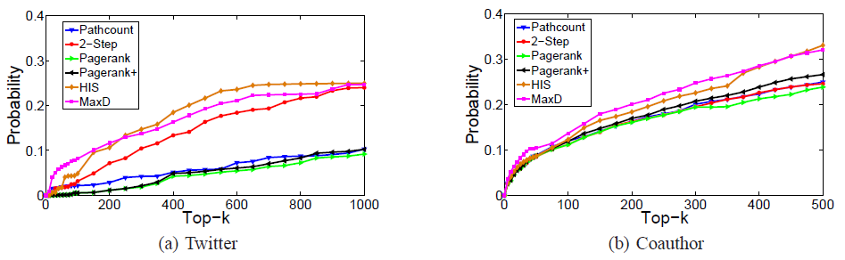
Maximization of Information Spread
Clear improvement. (2.5 times)
Top 0.2% - 10 %
Top 1% - 25 %
    Improvement is limited, due to top a few authors dominate.
    Improvement is statistically significant (p << 0.01)
Notes:
For the information spread maximization, we employ twitter and coauthor as the basis, we study how the detected SHS control the diffusion of information.
We can see that, on the twitter netowrk. top 0.2%.
On the coauthor network. …………

Slide 41
Case study on the inventor network
Most structural holes have more than one jobs.
Mark * on inventors with highest PageRank scores.
  HIS selects people with highest PageRank scores,
  MaxD tends to select people how have been working on more jobs.
Inventor | HIS | MaxD | Title
E. Boyden |  | √ | Professor (MIT Media Lab)
 |  |  | Associate Professor (MIT McGovern Inst.)
 |  |  | Group Leader (Synthetic Neurobiology)
A. Czarnik |  | √ | Founder and Manager (Protia, LLC)
 |  |  | Visiting Professor (University of Nevada)
 |  |  | Co-Founder (Chief Scientific Officer)
A. Nishio |  | √ | Director of Operations (WBI)
 |  |  | Director of Department Responsible (IDA)
E. Nowak* | √ |  | Senior vice President (Walt Disney)
 |  |  | Secretary of Trustees (The New York Eye)
Rofougaran | √ |  | Consultant (various wireless companies)
 |  |  | Co-founder (Innovent System Corp.)
 |  |  | Leader (RF-CMOS)
S. Yamazaki* | √ |  | President and majority shareholder (SEL)
Notes:
Now, let me present a case study on the Inventor network.
The table lists top-3 SHS detected by two models.
We find that most SHS have been working in more than one job.

Slide 42
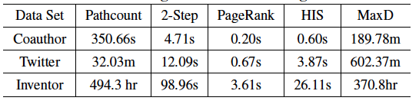
Efficiency
Running time of different algorithms in three data sets
Inefficient!!

Slide 43
Applications

Slide 44
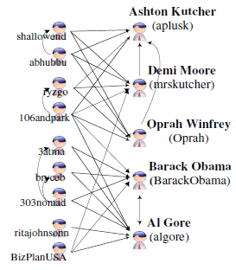
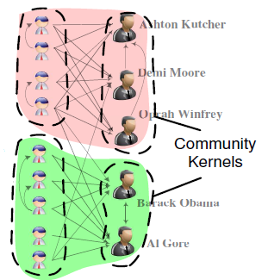
Detecting Kernel Communities
Community kernel detection
  GOAL : obtain the importance of each node within each community (as kernel members).
  HOW : kernel members are more likely to connect structural hole spanners.
[1] L. Wang, T. Lou, J. Tang, and J. E. Hopcroft. Detecting Community Kernels in Large Social Networks. In ICDM’11. pp. 784-793.
Notes:
Now, we turn to discuss how structural hole spanners can help real social applications.
Specifically, we consider community kernel detection, to ….
According to the fact that, kernel members are more likely to ……
We incorporate the SHS into the objective function and archive ….

Slide 45
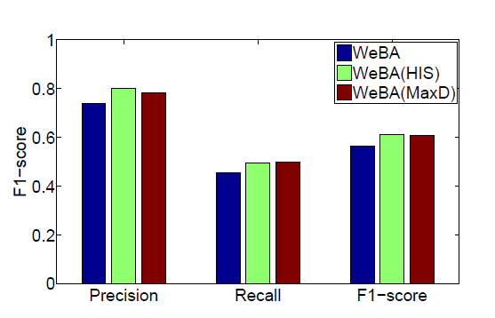
Detecting Kernel Communities
Community kernel detection
  GOAL : obtain the importance of each node within each community (as kernel members).
  HOW : kernel members are more likely to connect structural hole spanners.
  Clear improvements on F1-score, average of 5%

Slide 46
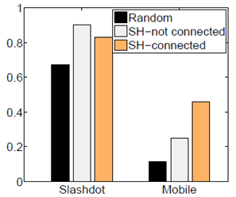
Model applications
Link prediction
  GOAL : predict the types of social relationships (on Mobile and Slashdot)
  HOW : users are more likely to have the same type of relationship with structural hole spanners.
Probabilities that two users (A and B) have the same type of relationship with user C, conditioned on whether user C spans a structural hole or not.
[1] J. Tang, T. Lou, and J. Kleinberg. Inferring Social Ties across Heterogeneous Networks. In WSDM’12. pp. 743-752.
Notes:
We also consider link prediciton, to predict friendship in slashdot and mobile.
We find that, …………
We add some binary correlation features into the predictive model, which archive.

Slide 47
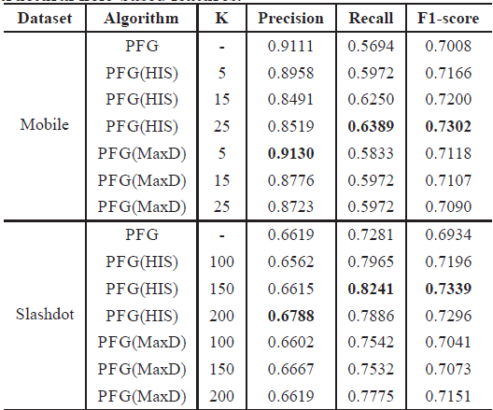
Model applications
Link prediction
  GOAL : predict the types of social relationships (on Mobile and Slashdot)
  HOW : users are more likely to have the same type of relationship with structural hole spanners.
  Significantly improvement of 1% to 6%
[1] J. Tang, T. Lou, and J. Kleinberg. Inferring Social Ties across Heterogeneous Networks. In WSDM’12. pp. 743-752.

Slide 48
Conclusion

Slide 49
Conclusion
Study an interesting problem : structural hole spanner detection.
Propose two models (HIS and MaxD) to detect structural hole spanner in large social networks, and provide theoretical analysis.
Results
  1% twitter users control 25% retweeting behaviors between communities.
  Application to Community kernel detection and Link prediction
Notes:
In the work, we study ……….
We ………
We discover an interesting phenoninon, 1% - 25%.
This provides a strong evidence for the existence of structural hole.
We also use the results to help some other social applications.

Slide 50
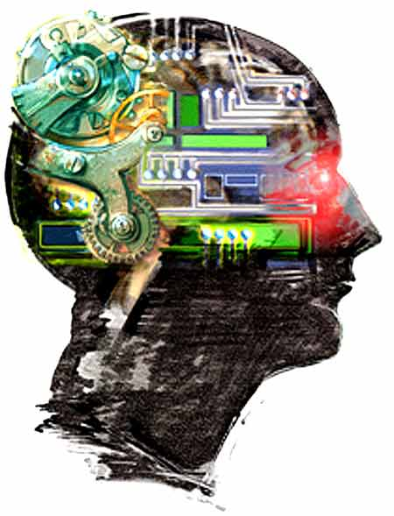
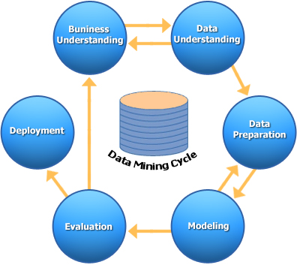
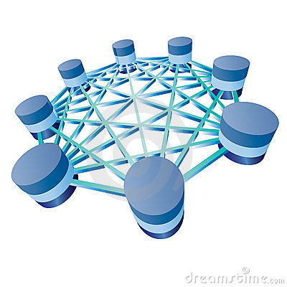





Future works
Combine the topic leveled information with the user network information.
Dynamics of structural holes
What’s the difference between the patterns of structural hole spanners on other networks?
Artificial Intelligence
Data Mining
Database
Notes:
For future works, first, we want to combine topic leveled information with ..
Dynamic of SH.
Twitter,

Slide 51
Thanks you！
Collaborators: Tiancheng Lou (Google)
Jon Kleinberg (Cornell),
Yang Yang, Cheng Yang (THU)
  Jie Tang, KEG, Tsinghua U, http://keg.cs.tsinghua.edu.cn/jietang
  Download data & Codes, http://arnetminer.org/download

Slide 52
Hardness Proof
Instance G = (V, E) of K-Denest Subgraph
1
e1
Minimal node-cut problem
2
e2
e3
1
3
e4
1
2
4
2
e5
Source
3
Sink
3
e6
4
5
4
5
5
6
capacity = 1, iff corresponding node exists in the edge (set of 2 nodes)
capacity = (|V|² + 1) |E|
Notes:
Given a instance of …
The graph consists of 5 vertices and 6 edges.
We first build a bi-partite graph of 5 + 6 nodes, if the corresponding nodes exists in the edge, we add one link between them with capacity 1.
Then, we add the source and destination of the network with a very large capacity.

Slide 53
Hardness Proof
Instance G = (V, E) of K-Denest Subgraph
Minimal node-cut problem
1
e1
1
2
2
e2
3
4
3
e3
1
5
e4
1
6
4
2
2
Sink
e5
Source
Sink
3
…(|V|²+1) times
3
e6
1
4
5
4
2
5
3
5
4
5
6
capacity = 1, iff corresponding node exists in the edge (set of 2 nodes)
capacity = (|V|² + 1) |E|
Instance φ is satisfied iff there exists a subset |V_{SH}| = k, such that Q(V_{SH}, C) >= d(|V|²+1)
Notes:
Finally, we duplicate the right side (|V|^2+1) times.
And we argue that, ……

