Slide 1
Cross-domain Collaboration Recommendation
Jie Tang¹, Sen Wu¹, Jimeng Sun², Hang Su¹
¹Tsinghua University
²IBM TJ Watson Research Center
Notes:
1

Slide 2
Cross-domain Collaboration
Interdisciplinary collaborations have generated huge impact, for example,
  51 (>1/3) of the KDD 2012 papers are result of cross-domain collaborations between graph theory, visualization, economics, medical inf., DB, NLP, IR
  Research field evolution
Biology
bioinformatics
Computer
Science
Notes:
collaborations between biology and computer science revolutionized the field of bioinformatics.
Because of the cross-domain collaborations, originally extremely expensive tasks such DNA sequence analysis have become scalable and affordable to a much broader population.

Slide 3
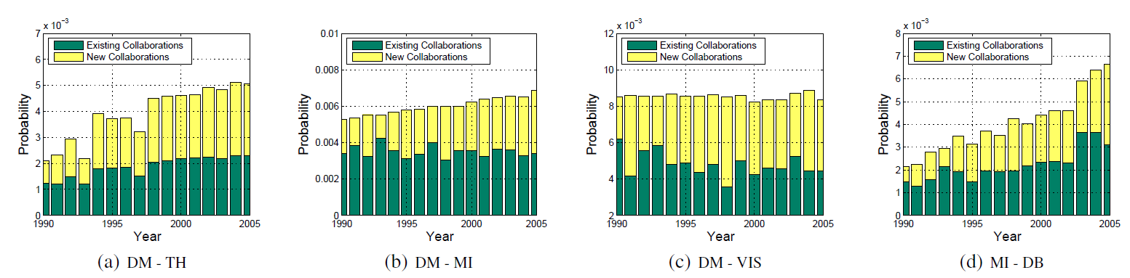
Cross-domain Collaboration (cont.)
Increasing trend of cross-domain collaborations
Data Mining(DM), Medical Informatics(MI), Theory(TH), Visualization(VIS)
Notes:
increasing trend of cross-domain collaborations over the past fifteen years across different domains in a
publication database (Cf. § 4 for details). In most of the cases, there exists a clear increasing trend of the cross-domain collaborations.

Slide 4



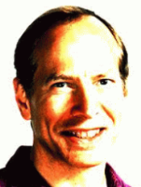

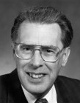




Challenges
Sparse Connection: <1%
Data Mining
1
Theory
Large graph
?
?
Automata theory
heterogeneous network
Complementary expertise
Graph theory
2
Sociall network
Complexity theory
Topic skewness: 9%
3
Notes:
Describe the problem
First, sparse connection, compared to traditional collaborations within a domain, cross-domain collaborations are very rare. partly because it is difficult for an outsider to find the right collaborator in the field that one does not know. This also makes it challenging to directly use a supervised learning approach due to the lack of training samples.
Second, complementary expertise, cross-domain collaborators often have different expertise and interest; For example, data mining researchers can easily identify who they want to work with in the data mining field, because they are familiar with the sub topics. However, for a cardiologist who wants to apply data mining techniques to predict heart failures, it will be difficult for her to find the right collaborators in data mining. Because these two fields (cardiology and data mining) are totally different with different terminology and problems. It is very difficult for one from cardiology to identify the right topics in data mining to look for collaborators.
Third, topic skewness, not all topics are relevant for crossdomain collaborations. In fact, in our study, only less than one-tenth of all possible topics pairs across domains have collaborations. Therefore, for the task of cross-domain collaboration recommendation, we should focus on better modeling those topics with high probability of having cross-domain collaborations

Slide 5
Related Work-Collaboration recommendation
Collaborative topic modeling for recommending papers
  C. Wang and D.M. Blei. [2011]
On social networks and collaborative recommendation
  I. Konstas, V. Stathopoulos, and J. M. Jose. [2009]
CollabSeer: a search engine for collaboration discovery
  H.-H. Chen, L. Gou, X. Zhang, and C. L. Giles. [2007]
Referral web: Combining social networks and collaborative filtering
  H. Kautz, B. Selman, and M. Shah. [1997]
Fab: content-based, collaborative recommendation
  M. Balabanovi and Y. Shoham. [1997]

Slide 6
Related Work-Expert finding and matching
Topic level expertise search over heterogeneous networks
  J. Tang, J. Zhang, R. Jin, Z. Yang, K. Cai, L. Zhang, and Z. Su. [2011]
Formal models for expert finding in enterprise corpora
  K. Balog, L. Azzopardi, and M.de Rijke. [2006]
Expertise modeling for matching papers with reviewers
  D. Mimno and A. McCallum. [2007]
On optimization of expertise matching with various constraints
  W. Tang, J. Tang, T. Lei, C. Tan, B. Gao, and T. Li. [2012]

Slide 7
Approach Framework
—Cross-domain Topic Learning

Slide 8

Author Matching
Data Mining
Medical Informatics
G^{S}
G^{T}
Cross-domain coauthorships
Author
Sparse connection!
v₁
v'₁
1
v₂
v'₂
…
…
Coauthorships
v_{N}
v' _{N'}
v_{q}
Query user
Notes:
Based on the historic cross-domain collaborations, we create a collaboration graph, as shown in Figure 2(a).
The problem is to rank relevant nodes in the target domain GT for a given query node vq in the source domain GS. Measuring the relatedness of two nodes in the graph can be achieved using the Random Walks with Restarts (RWR) theory [22, 28]. Starting from node vq, a RWR is performed by following a link to another node according to the weight of the link at each step.1 Also, in every step, there is a probability to return the node vq. The relatedness score of node
vi wrt node vq is defined as the stationary probability ri that the random walk will finally arrive node vi,
The problem of the author matching method is that the connections across the two domains are rare. This makes it difficulty for ….
Another problem for the The author matching method is that it only considers the network structure information, but ignores the content (topic) information.

Slide 9
Topic Matching
Topics Extraction
Data Mining
Medical Informatics
Topics
Topics
Complementary Expertise!
Topic skewness!
G^{S}
G^{T}
z₁
2
z'₁
v₁
3
v'₁
z₂
z'₂
v₂
v'₂
…
z₃
z'₃
…
…
…
v_{N}
z_{T}
z'_{T}
v' _{N'}
v_{q}
Topics correlations
Notes:
First, we apply the topic model such as LDA or ACT model to the source and the target domains respectively and obtain two sets of topic distributions. Then we estimate the alignment between topics of these two domains. We calculate the alignment according to the historic cross-domain collaborations.

Slide 10
Cross-domain Topic Learning
Identify “cross-domain” Topics
Data Mining
Medical Informatics
Topics
G^{S}
G^{T}
z₁
v₁
v'₁
z₂
v₂
v'₂
…
z₃
…
v_{N}
…
v' _{N'}
z_{K}
v_{q}
Notes:
The topic matching method does not discriminate the “collaboration” topics from those topics existing in only one domain. As a result, the “irrelevant” topics (irrelevant to collaboration) may hurt the collaboration recommendation performance. We develop a new topic modeling approach called Cross-domain Topic Learning (CTL) to model topics of the source domain and the target domain simultaneously.

Slide 11
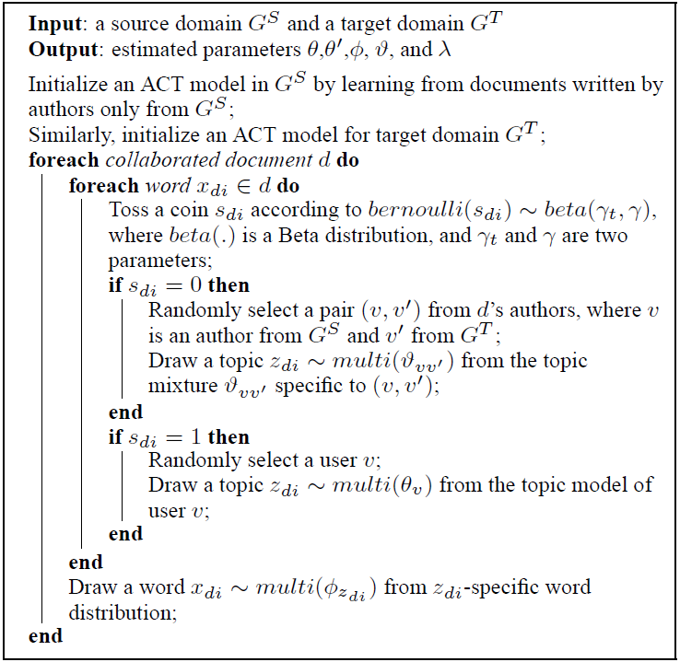
Collaboration Topics Extraction
Step 1:
Step 2:
Notes:
The basic idea here is to use two correlated generative processes to model the source and the target domains together. The first process is tomodel documents written by authors from single domain (either source or target). The second process is to model collaborated documents. For each word in a collaborated document, we use a Bernoulli distribution to determine whether it is generated from a “collaboration” topic or a topic-specific to one domain only.

Slide 12
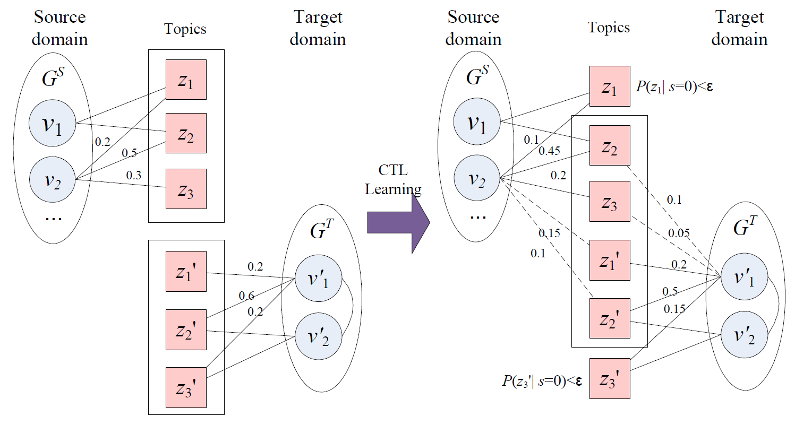
Intuitive explanation of Step 2 in CTL
Collaboration topics
Notes:
Figure 4 illustrates an example of CTL learning. Before CTL learning, each author only has topic distribution in either source or target domain (zero probability on topics from the other domain).
Then, CTL smoothes topics distributions across the two domains. Users from the source domain will also have a probability over topics extracted from the target domain, and vice versa. After training the CTL model, we also obtain a set of “collaboration topics” between the two domains, i.e., topics with the highest posterior probabilities
P(z|s = 0, ·) (or P(z|s = 0, ·) > ) in the collaborated documents. (Here, · indicates all the other parameters we should consider when calculating the probability.) For example in right hand side of Figure 4, the box indicates those collaboration topics.

Slide 13
Experiments

Slide 14
Data Set and Baselines
Arnetminer (available at http://arnetminer.org/collaboration)
Baselines
  Content Similarity(Content)
  Collaborative Filtering(CF)
  Hybrid
  Katz
  Author Matching(Author), Topic Matching(Topic)
Domain | Authors | Relationships | Source
Data Mining | 6,282 | 22,862 | KDD, SDM, ICDM, WSDM, PKDD
Medical Informatics | 9,150 | 31,851 | JAMIA, JBI, AIM, TMI, TITB
Theory | 5,449 | 27,712 | STOC, FOCS, SODA
Visualization | 5,268 | 19,261 | CVPR, ICCV, VAST, TVCG, IV
Database | 7,590 | 37,592 | SIGMOD, VLDB, ICDE
Notes:
We consider the following five sub-domains: • Data Mining: We use papers of the following data mining
conferences: KDD, SDM, ICDM, WSDM and PKDD, which result in a network with 6,282 authors
and 22,862 co-author relationships.
Content Similarity(Content)
Based on similarity between authors’ publications
Collaborative Filtering(CF)
Leverage the existing collaborations to make the recommendation.
Hybrid
Linear combination of the scores obtained by the Content and the CF methods.
Katz
Best link predictor in link-prediction problem for social networks
Author Matching(Author)
Based on the random walk with restart on the collaboration graph
Topic Matching(Topic)
Combining the extracted topics into the random walking algorithm

Slide 15
Performance Analysis
Training: collaboration before 2001 Validation: 2001-2005
Cross Domain | ALG | P@10 | P@20 | MAP | R@100 | ARHR -10 | ARHR -20
Data Mining(S) to Theory(T) | Content | 10.3 | 10.2 | 10.9 | 31.4 | 4.9 | 2.1
 | CF | 15.6 | 13.3 | 23.1 | 26.2 | 4.9 | 2.8
 | Hybrid | 17.4 | 19.1 | 20.0 | 29.5 | 5.0 | 2.4
 | Author | 27.2 | 22.3 | 25.7 | 32.4 | 10.1 | 6.4
 | Topic | 28.0 | 26.0 | 32.4 | 33.5 | 13.4 | 7.1
 | Katz | 30.4 | 29.8 | 21.6 | 27.4 | 11.2 | 5.9
 | CTL | 37.7 | 36.4 | 40.6 | 35.6 | 14.3 | 7.5
Content Similarity(Content): based on similarity between authors’ publications
Collaborative Filtering(CF): based on existing collaborations
Hybrid: a linear combination of the scores obtained by the Content and the CF methods.
Katz: the best link predictor in link-prediction problem for social networks
Author Matching(Author): based on the random walk with restart on the collaboration graph
Topic Matching(Topic): combining the extracted topics into the random walking algorithm

Slide 16
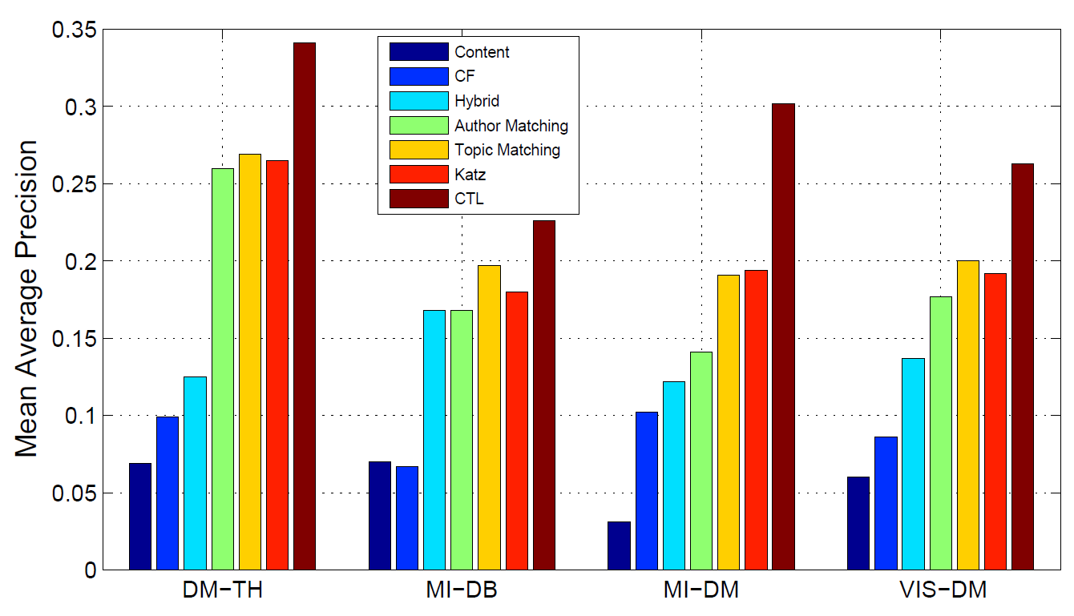
Performance on New Collaboration Prediction
CTL can still maintain about 0.3 in terms of MAP which is significantly higher than baselines.

Slide 17
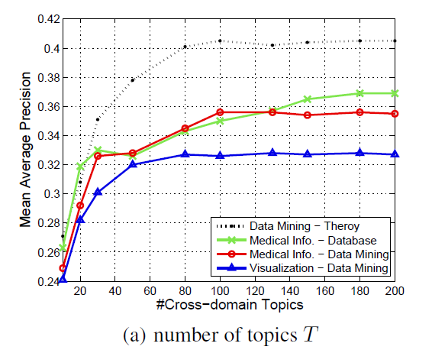
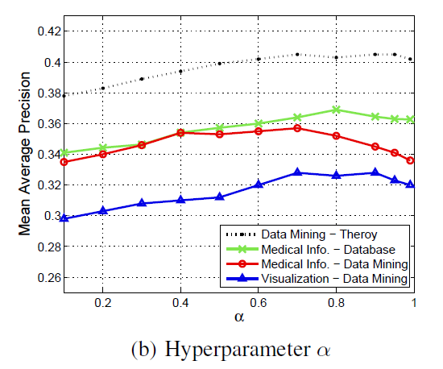
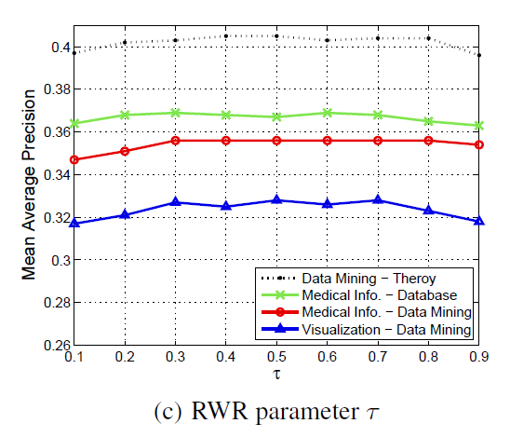
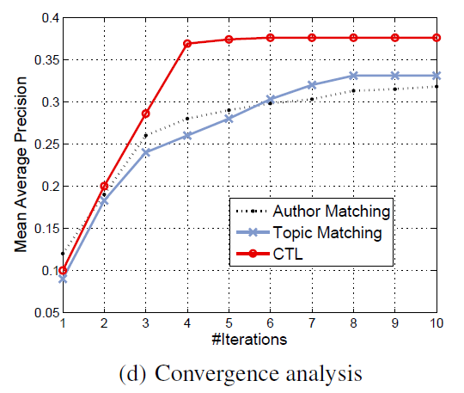
Parameter Analysis
(a) varying the number of topics T (b) varying α parameter
(c) varying the restart parameter τ in the random walk (d) Convergence analysis

Slide 18
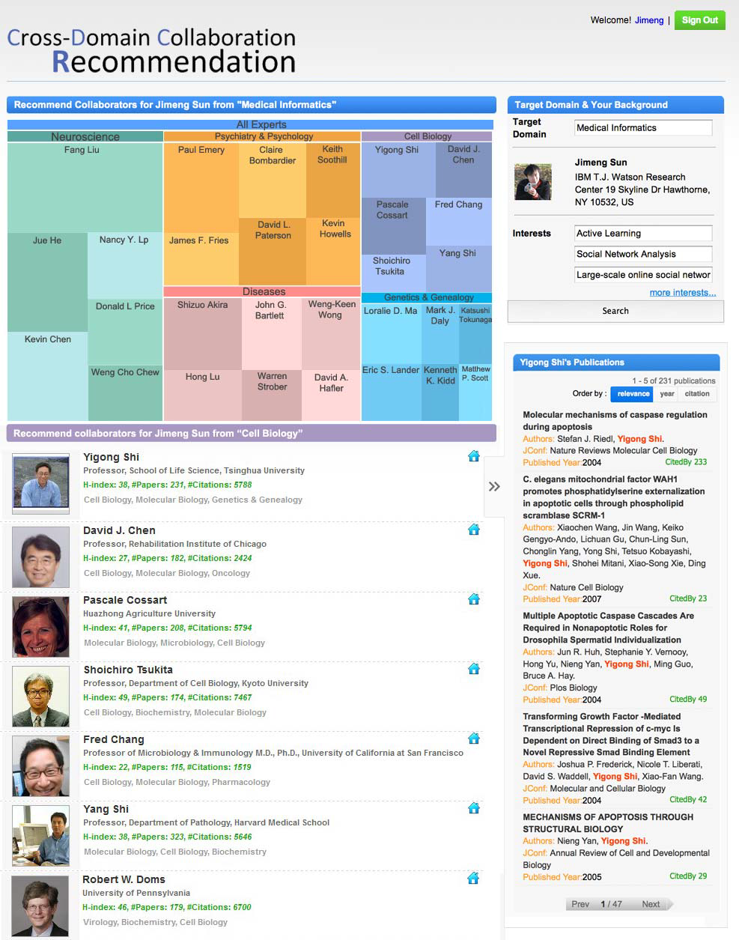
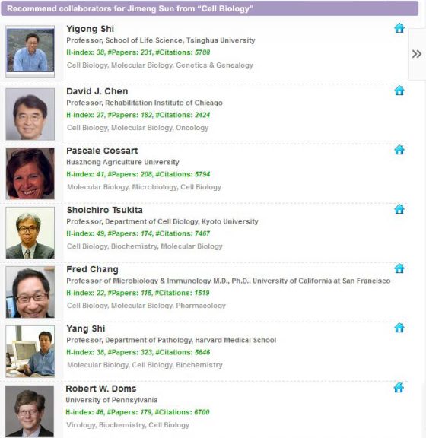
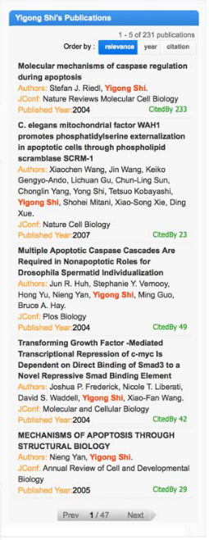
Prototype System http://arnetminer.org/collaborator
Treemap: representing subtopic
in the target domain
Recommend Collaborators &
Their relevant publications

Slide 19
Conclusion
Study the problem of cross-domain collaboration recommendation
Propose the cross-domain topic model for recommending collaborators
Experimental results in a coauthor network demonstrate the effectiveness and efficiency of the proposed approach

Slide 20
Future work
Connect cross-domain collaborative relationships with social theories (e.g. social balance, social status, structural hole)
Apply the proposed method to other networks

Slide 21
Thanks!
System: http://arnetminer.org/collaborator
Code&Data: http://arnetminer.org/collaboration

Slide 22
Challenge always be side with opportunity!
Sparse connection:
  cross-domain collaborations are rare;
Complementary expertise:
  cross-domain collaborators often have different expertise and interest;
Topic skewness:
  cross-domain collaboration topics are focused on a subset of topics.
How to handling these patterns?

Slide 23
Performance Analysis
Cross Domain | ALG | P@10 | P@20 | MAP | R@100 | ARHR -10 | ARHR -20
Medical Info.(S) to Database(T) | Content | 10.1 | 10.9 | 12.5 | 45.9 | 3.6 | 2.1
 | CF | 18.3 | 20.2 | 21.4 | 47.6 | 5.3 | 3.9
 | Hybrid | 25.0 | 26.5 | 28.4 | 59.1 | 6.4 | 4.2
 | Author | 26.2 | 29.6 | 32.2 | 54.8 | 10.5 | 5.4
 | Topic | 29.4 | 26.3 | 34.7 | 59.3 | 11.5 | 5.2
 | Katz | 27.5 | 28.3 | 30.7 | 57.2 | 10.5 | 5.0
 | CTL | 32.5 | 30.0 | 36.9 | 59.8 | 11.4 | 5.4
Content Similarity(Content): based on similarity between authors’ publications
Collaborative Filtering(CF): based on existing collaborations
Hybrid: a linear combination of the scores obtained by the Content and the CF methods.
Katz: the best link predictor in link-prediction problem for social networks
Author Matching(Author): based on the random walk with restart on the collaboration graph
Topic Matching(Topic): combining the extracted topics into the random walking algorithm

Slide 24
Performance Analysis
Cross Domain | ALG | P@10 | P@20 | MAP | R@100 | ARHR -10 | ARHR -20
Medical Info.(S) to Data Mining(T) | Content | 5.8 | 5.7 | 9.5 | 19.8 | 1.9 | 0.9
 | CF | 13.7 | 17.8 | 18.9 | 34.3 | 2.7 | 1.3
 | Hybrid | 18.0 | 19.0 | 19.8 | 36.7 | 3.4 | 1.3
 | Author | 20.1 | 23.8 | 29.3 | 64.4 | 5.3 | 2.1
 | Topic | 26.0 | 25.0 | 33.9 | 48.1 | 10.7 | 5.6
 | Katz | 21.2 | 23.8 | 32.4 | 48.1 | 10.2 | 4.8
 | CTL | 30.0 | 24.0 | 35.6 | 49.6 | 12.2 | 6.0
Content Similarity(Content): based on similarity between authors’ publications
Collaborative Filtering(CF): based on existing collaborations
Hybrid: a linear combination of the scores obtained by the Content and the CF methods.
Katz: the best link predictor in link-prediction problem for social networks
Author Matching(Author): based on the random walk with restart on the collaboration graph
Topic Matching(Topic): combining the extracted topics into the random walking algorithm

Slide 25
Performance Analysis
Cross Domain | ALG | P@10 | P@20 | MAP | R@100 | ARHR -10 | ARHR -20
Visual.(S) to Data Mining(T) | Content | 9.6 | 11.8 | 13.2 | 18.9 | 3.1 | 1.8
 | CF | 14.0 | 20.8 | 26.4 | 29.4 | 6.9 | 4.3
 | Hybrid | 16.0 | 20.0 | 27.6 | 30.1 | 6.3 | 4.4
 | Author | 22.0 | 25.2 | 27.7 | 31.1 | 11.9 | 6.7
 | Topic | 26.3 | 25.0 | 32.3 | 31.4 | 13.2 | 8.8
 | Katz | 23.0 | 25.1 | 29.3 | 30.2 | 10.4 | 5.4
 | CTL | 28.3 | 26.0 | 32.8 | 36.3 | 14.0 | 9.1
Content Similarity(Content): based on similarity between authors’ publications
Collaborative Filtering(CF): based on existing collaborations
Hybrid: a linear combination of the scores obtained by the Content and the CF methods.
Katz: the best link predictor in link-prediction problem for social networks
Author Matching(Author): based on the random walk with restart on the collaboration graph
Topic Matching(Topic): combining the extracted topics into the random walking algorithm

